Slide 1

Jingwei Wu, PhD
Chapter 1
Introduction to Statistics
A courtesy of “USING AND INTERPRETING STATISTICS” by ERIC W. CORTY | THIRD EDITION (Macmillan Education)

Slide 2

Objectives
The Purpose of Statistics
Experiments and Variables
Levels of Measurement
The Language of Statistics
Statistical Notation and Rounding

Slide 3
The Purpose of Statistics
Statistics
Techniques used to summarize data in order to answer questions
Statistics bring order out of chaos

Slide 4
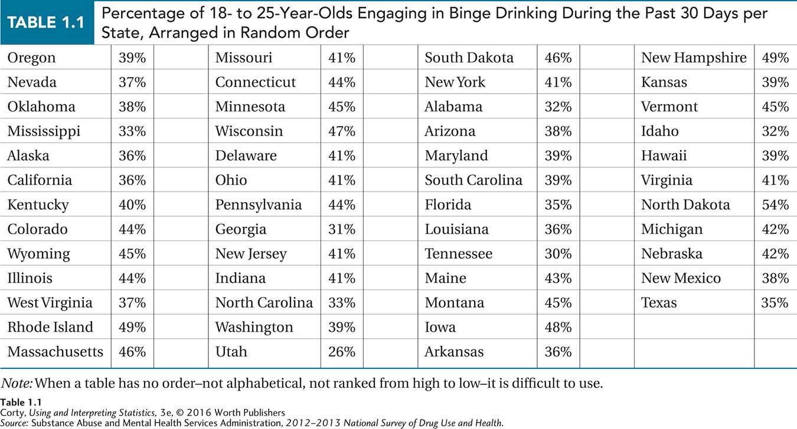
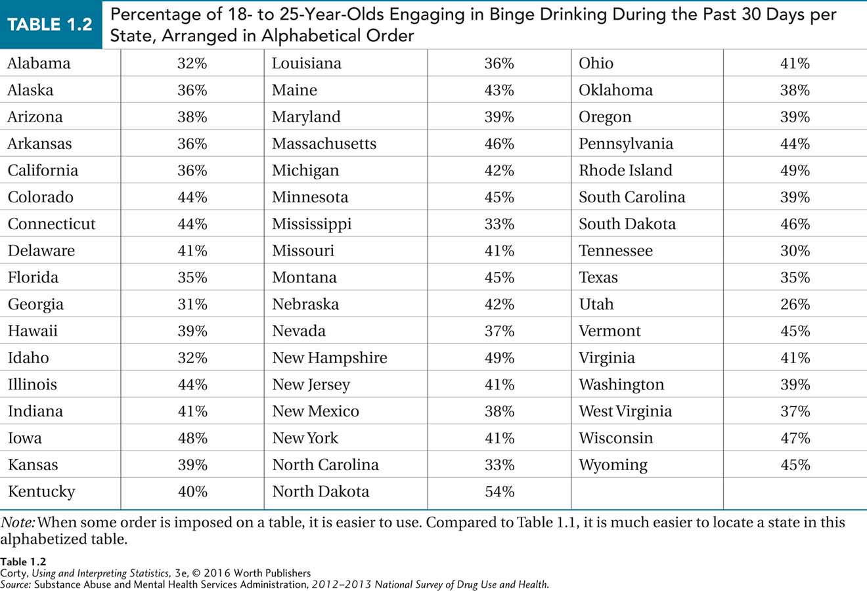
Percentage of 18- to 25-Year-Olds Engaging in Binge Drinking During the Past 30 Days per State
Table 1.1
Arranged in Random Order
Table 1.2
Arranged in Alphabetical Order by State

Slide 5
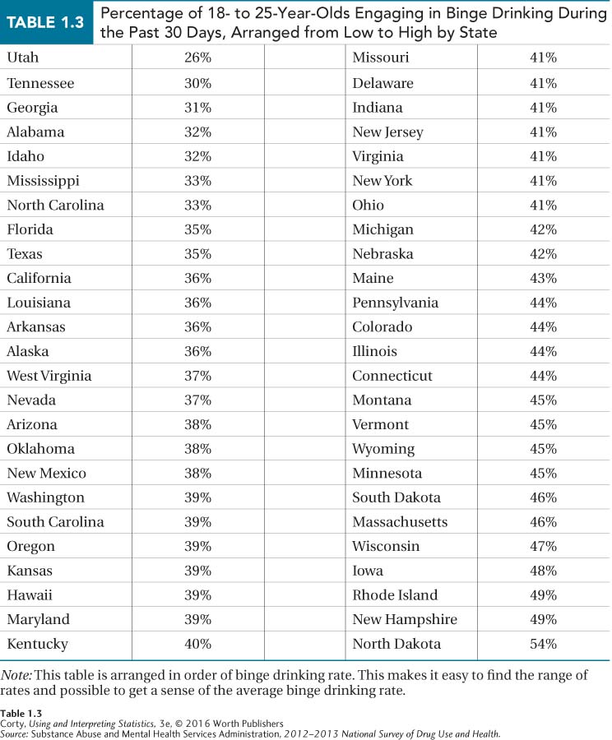
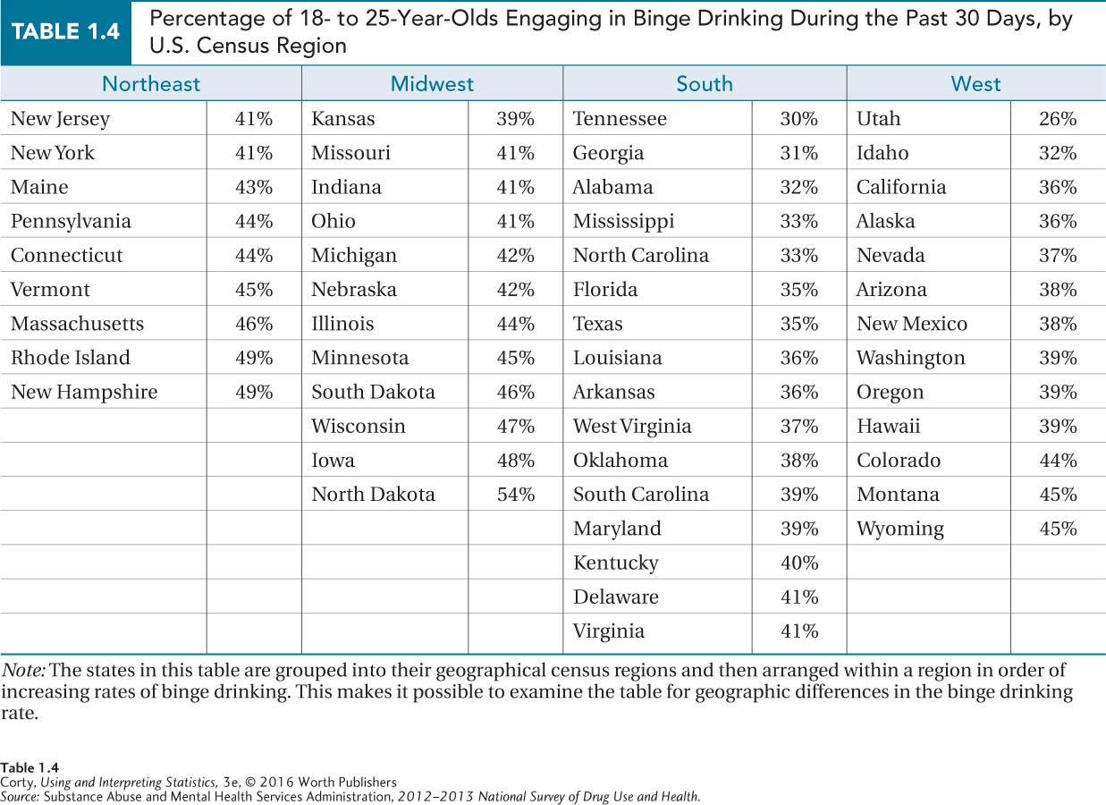
Percentage of 18- to 25-Year-Olds Engaging in Binge Drinking During the Past 30 Days per State
Table 1.3
Arranged from Low to High by State
Table 1.4
Arranged by U.S. Census Region by State

Slide 6
Experiments and Variables
Variables
Characteristics measured by researchers
Variables vary
Examples of characteristics commonly measured
Height, weight, intelligence, aggression, neurotransmitter levels
Cases
Subjects of a study, the objects on whom these variables are being measured
Examples of cases
States were cases in binge drinking tables shown earlier

Slide 7
Correlational Designs
Correlational design
Examines the relationship between two variables without any attempt to manipulate them
Two variables are measured or observed as they naturally occur
Advantage
Allows study of real-life relationships
Disadvantage
Cannot draw conclusion about cause and effect
Correlation is not causation

Slide 8
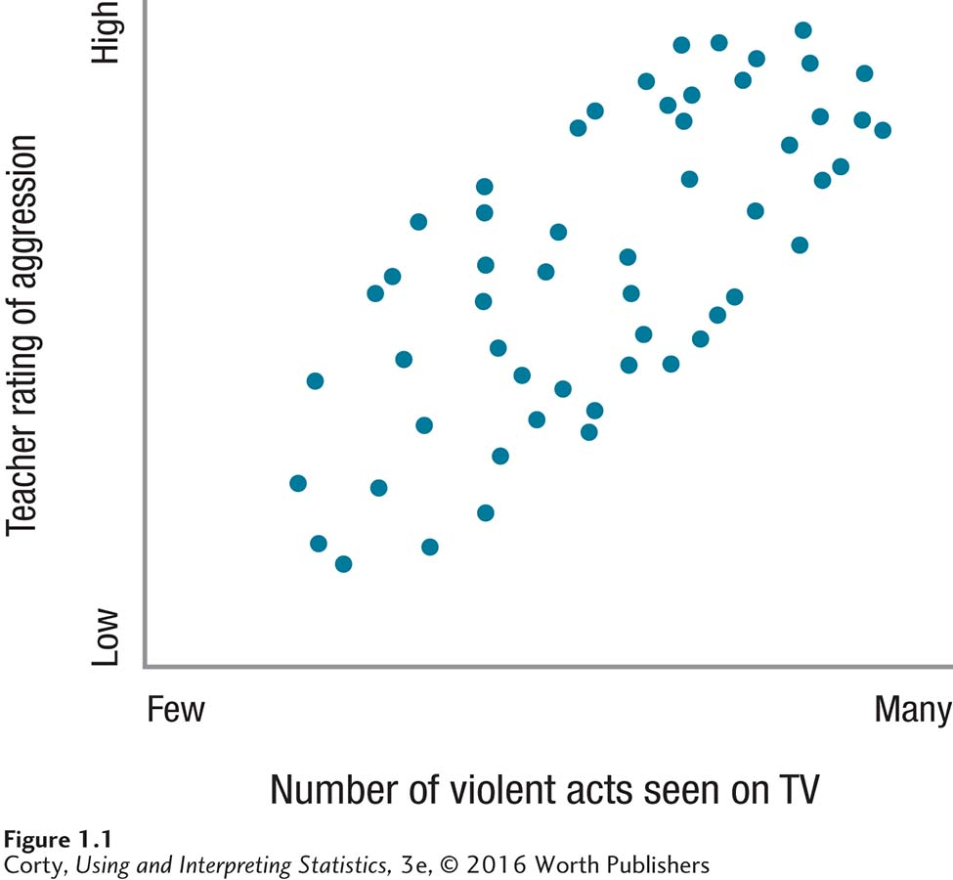
Correlational Designs, cont’d
TV and aggression study
Hypothetical results
Kids who watched more violent TV were rated as more aggressive
Tempting to conclude following
“TV violence causes aggression”
Can’t conclude with certainty
Correlation only tells that two variables are related

Slide 9
Correlational Designs, cont’d
TV and Aggression study
Three possible explanations exist
Does amount of violent TV (X) cause aggressive behavior (Y)?
Or, does aggressive behavior (Y) cause violent TV viewing (X)?
Or, does a third variable cause both X and Y? – confound
Confounding variable
Impact on both variables (X and Y), reason why the two variables covary
If confounding variables exist, X doesn’t cause Y and Y doesn’t cause X; confounding variable causes both
What might be confounding variables in this study?

Slide 10
Experimental Designs
Experimental design
Allows researchers to draw cause-and-effect conclusions
Independent variable (IV)
Manipulated or controlled by the experimenter
Dependent variable (DV)
Responds to IV; valuable depends on IV

Slide 11
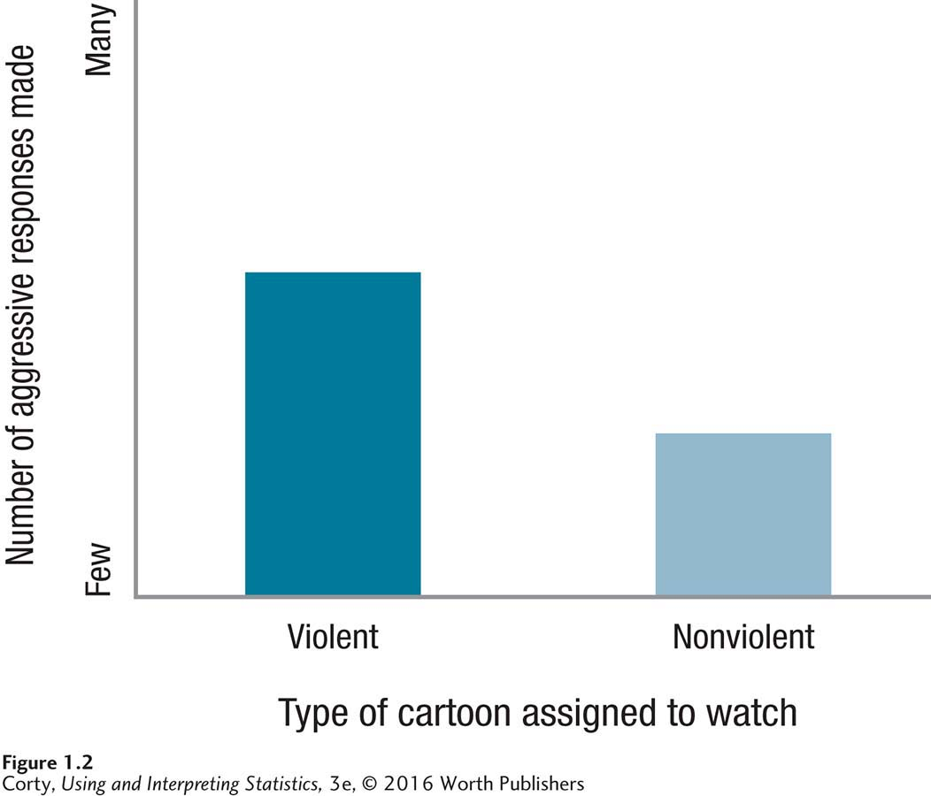
Experimental Designs
What are the hypothetical results of this experimental design?
TV and aggression study converted to experiment
Child watches either nonviolent or violent cartoon (IV)
Control group (watches nonviolent cartoon)
Experimental group (watches violent cartoon)
After watching cartoon, measure number of aggressive responses each child makes while playing a video game (DV)

Slide 12
Experimental Designs
Why independent variable (IV) causes differences on dependent variable (DV) due to random assignment:
If two groups are alike in all ways except IV (e.g., type of cartoon watched),
and two groups are found to differ on DV (e.g., number of aggressive responses),
then only plausible explanation (besides chance) for difference on the DV is IV

Slide 13
Quasi-Experimental Designs
Quasi-experimental design
Scientific study in which cases are classified into naturally occurring groups and then compared on a dependent variable
Cases are classified as being in different groups on basis of some characteristic they already possess
Not assigned to groups based on a variable that the researcher controls

Slide 14
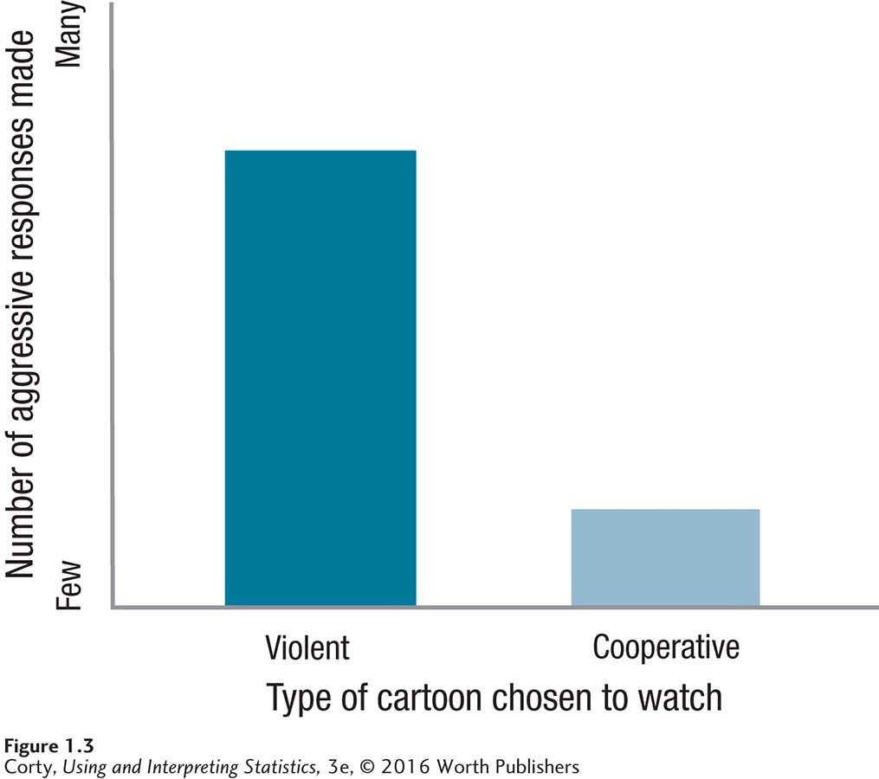
Quasi-Experimental Designs
What are the hypothetical results of this quasi-experimental design?
TV and aggression study converted to quasi-experimental
Child chooses which cartoon to watch
Violent cartoon with lots of hitting and fighting
Nonviolent cartoon with lots of cooperative acts
After watching cartoon, measure number of aggressive responses each child makes while playing a video game (DV)

Slide 15
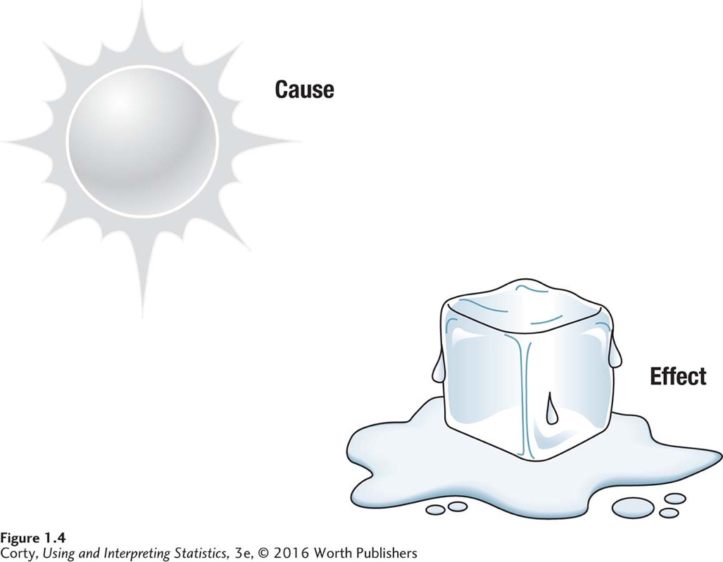
Independent and Dependent Variables
ICED: A mnemonic for types of variables The mnemonic ICED can be used to remember that the independent variable is the cause and the dependent variable is the effect that is measured.
independent = cause; effect = dependent
The sun is the cause of the melting of the ice cube

Slide 16
Guidelines to Determine Study Type to Be Used
Formulate a cause-and-effect statement.
Think about chronological order.
Often it is easier to determine the outcome variable first. The remaining variable is the explanatory variable.
Determine the most suitable type of research design.

Slide 17
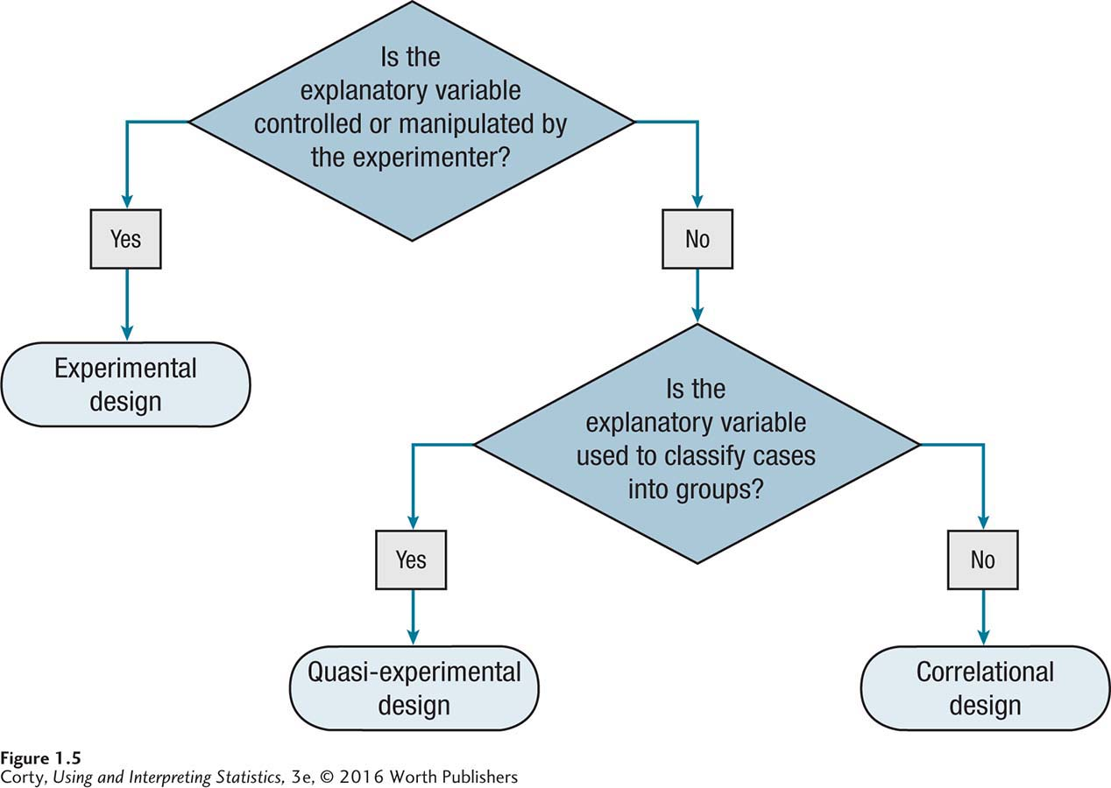
How to Choose: Type of Study
Once one has determined which variable is the explanatory variable, this flowchart can be used to determine whether the study is correlational, experimental, or quasi-experimental.
It depends on whether the explanatory variable is controlled by the experimenter and, if not, whether cases are classified into groups.

Slide 18
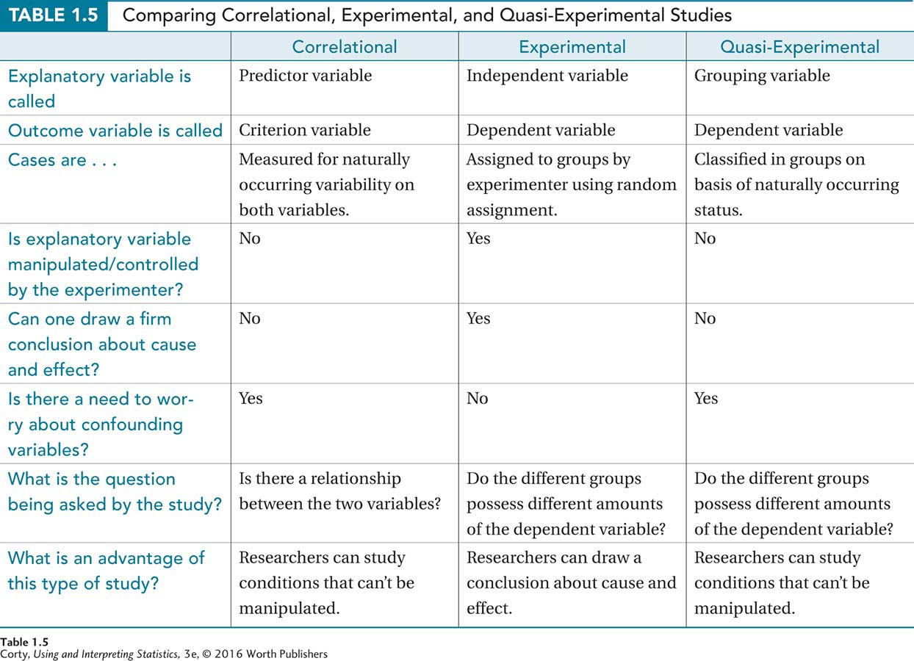
Stop and Recap
Compare correlational, experimental, and quasi-experimental studies by answering the following:
Explanatory variable is called _____.
Is explanatory variable manipulated/controlled by the experimenter?
Can one draw a firm conclusion about cause and effect?
Is there a need to worry about confounding variables?
What is the question being asked by the study?
What is an advantage of this type of study?

Slide 19
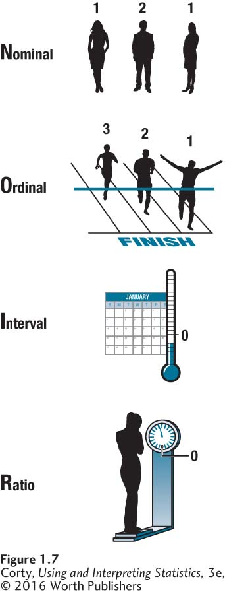
Levels of Measurement
French word for “black,” noir, can be used as a mnemonic for the four levels of measurement
Nominal
Ordinal
Interval
Ratio

Slide 20
Levels of Measurement
Nominal-level numbers
Numbers used to place cases in categories
Numbers are arbitrary and provide no quantitative information
Provide information about whether two things are the same or different

Slide 21
Levels of Measurement
Ordinal-level numbers
Are used to indicate if more or less of an attribute
Provide information about same or different
Give no information about how far apart cases are

Slide 22
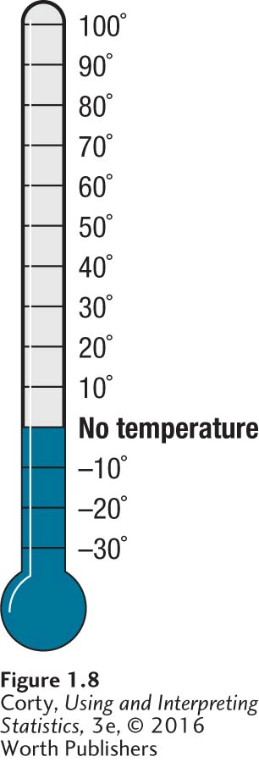
Levels of Measurement
Interval-level numbers
Provide information about attribute amount possessed, same/different and more/less
Have equality of units
Contain arbitrary zero point

Slide 23
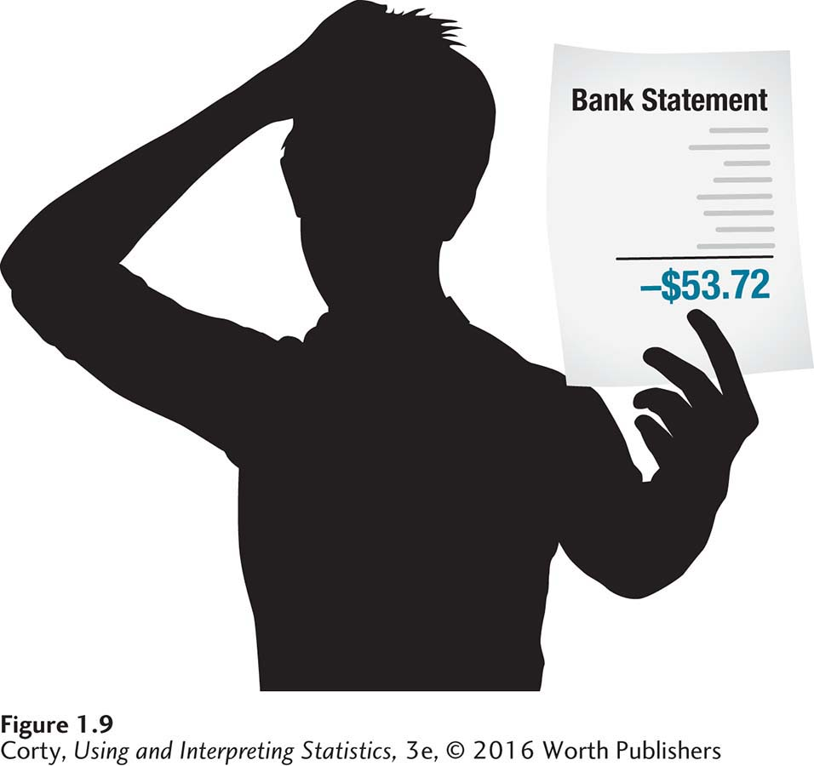
Levels of Measurement
Ratio-level numbers
Numbers have all the attributes of interval-level numbers
Real zero point
Numbers provide information about same/different, more/less
How much of an attribute is possessed
Can be used to calculate a proportion
Even though they have absolute zero points, some ratio-level measures can have negative values.

Slide 24
The Language of Statistics
In statistics, we generally want to study a population. You can think of a population as a collection of persons, things, or objects under study.
To study the population, we select a sample. The idea of sampling is to select a portion (or subset) of the larger population and study that portion (the sample) to gain information about the population.
Data are the result of sampling from a population.

Slide 25
More Key Terms
From the sample data, we can calculate a statistic. A statistic is a number that represents a property of the sample.
The statistic is an estimate of a population parameter. A parameter is a number that is a property of the population.
The accuracy of this estimate depends on how well the sample represents the population:
The sample must contain the characteristics of the population in order to be a representative sample.

Slide 26
More Key Terms
Descriptive Statistics
Summary statement about a set of cases
Reducing a set of data to a meaningful value in order to describe the characteristics of that group of observations
Inferential Statistics
Using observations from a sample to draw a conclusion about a population
Reducing a set of data to a meaningful value to make inferences about a population (rather than describe a sample)

Slide 27
An illustration
The process of statistical inference involves using information from a sample to draw conclusions about a wider population.
Population
Collect data from a representative Sample...
Sample
Make an Inference about the Population.
Remember s and p: statistics come from samples and
parameters come from populations.

Slide 28
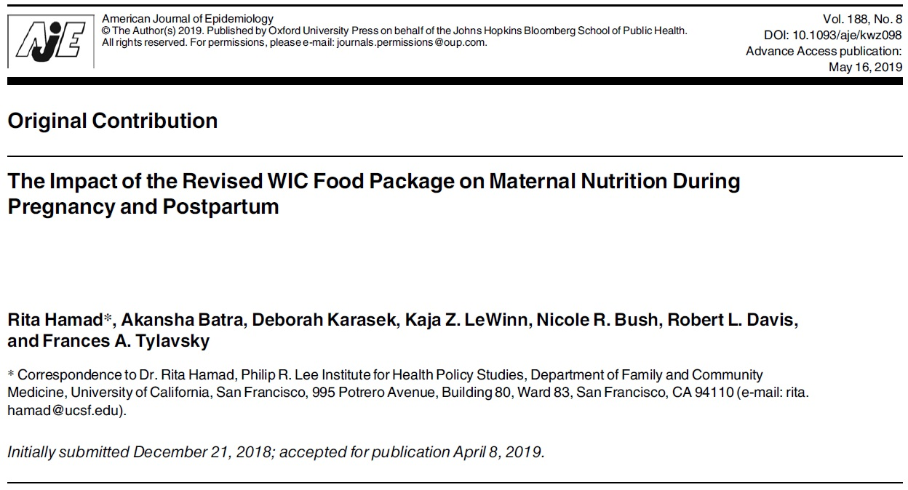
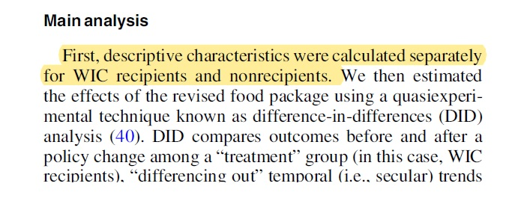
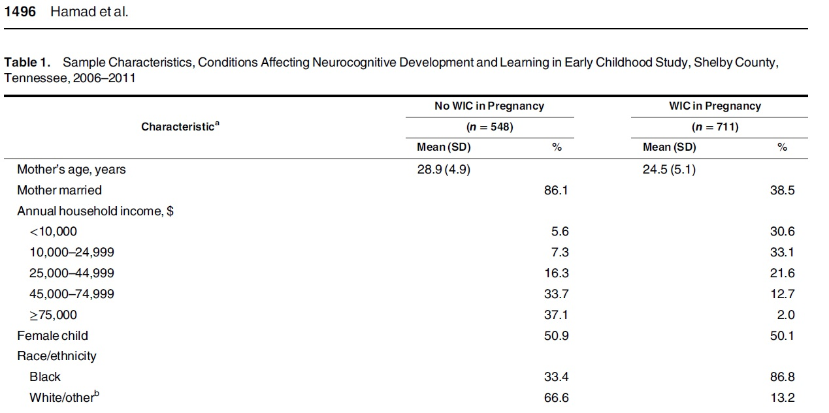

Slide 29

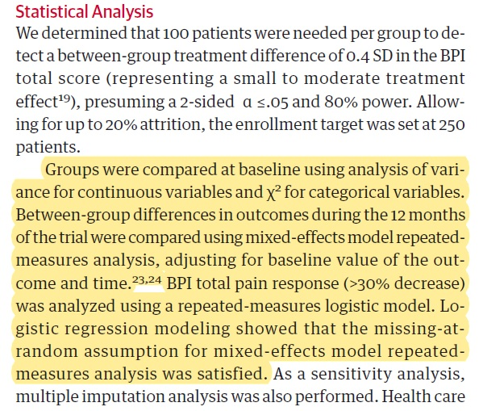
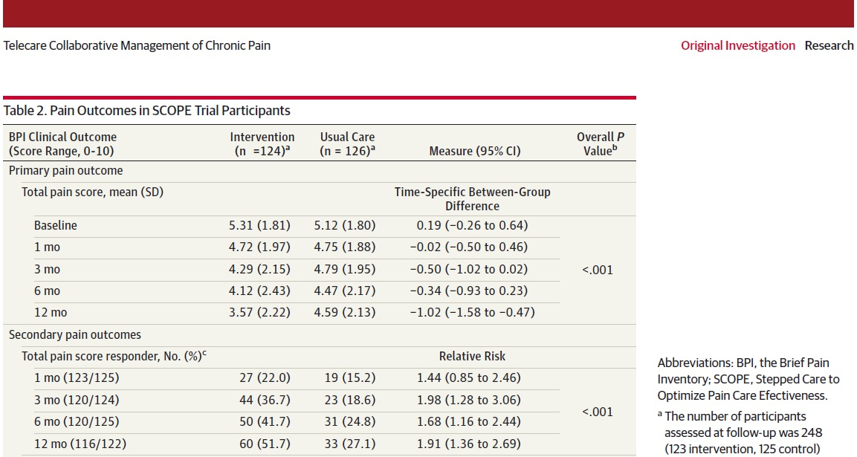
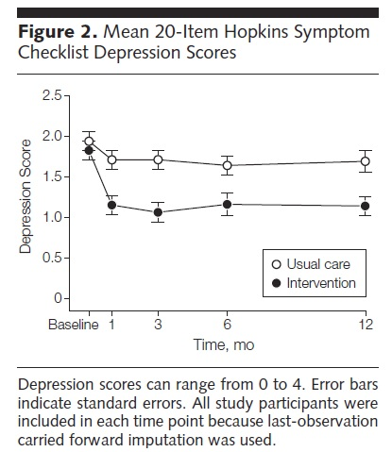

Slide 30
Example
Researchers want to investigate whether taking aspirin regularly reduces the risk of heart attack. Four hundred men between the ages of 50 and 84 are recruited as participants. The men are divided randomly into two groups: one group will take aspirin, and the other group will take a placebo. Each man takes one pill each day for three years, but he does not know whether he is taking aspirin or the placebo. At the end of the study, researchers count the number of men in each group who have had heart attacks. Identify the following values for this study: population, sample, cases, explanatory variable, outcome variable, treatments.
The population is men aged 50 to 84.
The sample is the 400 men who participated.
The cases are the individual men in the study.
The explanatory variable is oral medication.
The treatments are aspirin and a placebo.
The outcome variable is whether a subject had a heart attack.

Slide 31
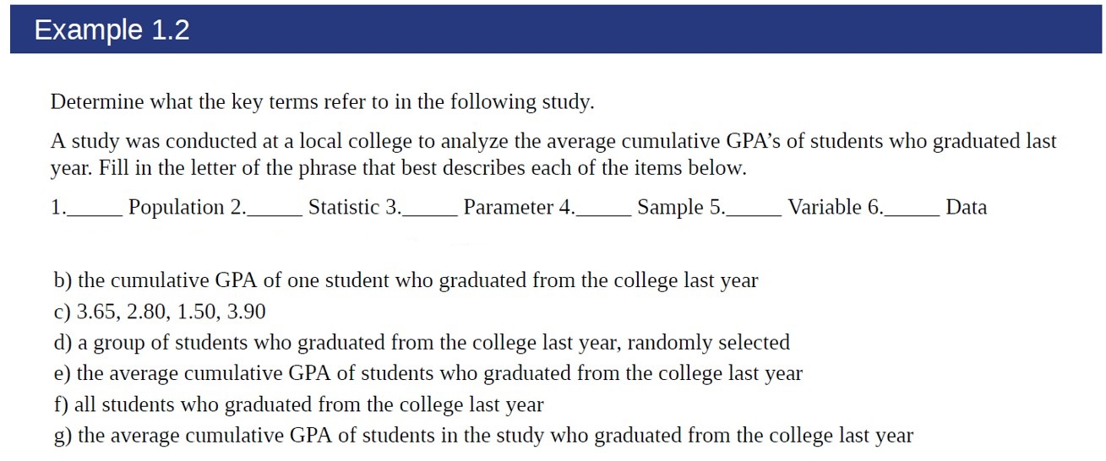
Example
1. f); 2. g); 3. e); 4. d); 5. b); 6. c)

Slide 32
Statistical Notation and Rounding
Dependent variables abbreviated with a letter
Example
Measuring age in a group of children
X = age
N to indicate the number of cases
Example
Measuring the ages of five children
N = 5
Uppercase Greek letter sigma (Σ) summation symbol
Example
Five children had ages of 5, 7, 10, 11, and 15
ΣX means to add all the X scores
ΣX = 5 + 7 + 10 + 11 +15
= 48

Slide 33
Order of Operations
The order of operations tells the order in which math is done. Following the order of operations is important for getting the right answer.
PEMDAS: Acronym for remembering operations order
“Please excuse my dear Aunt Sally”
Parentheses, exponents, multiplication, division, addition, and subtraction

Slide 34
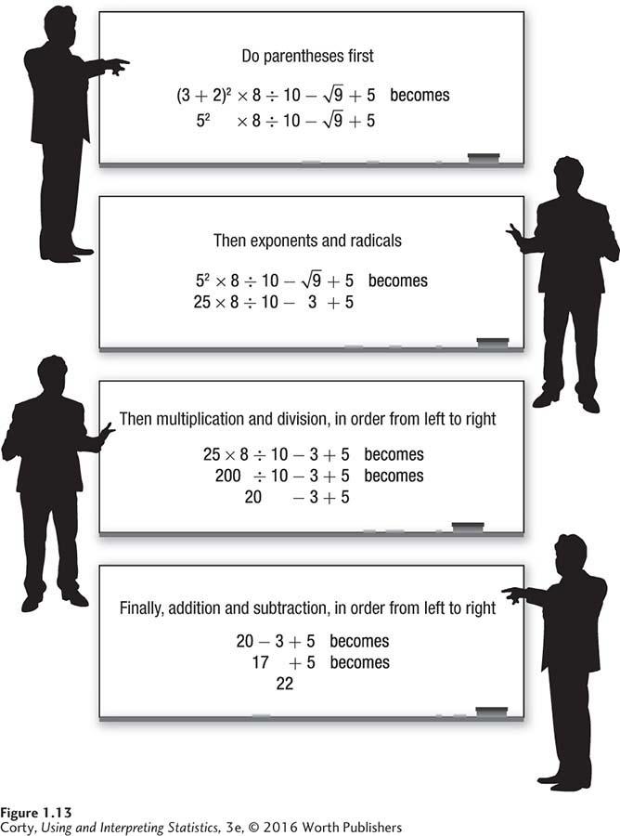
Order of Operations: Another Look
Math in equations should be done following these
four steps for order of operations: First the math within parentheses and radicals, then multiplication and division, finishing with addition and subtraction.

Slide 35
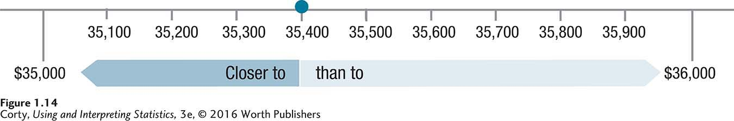
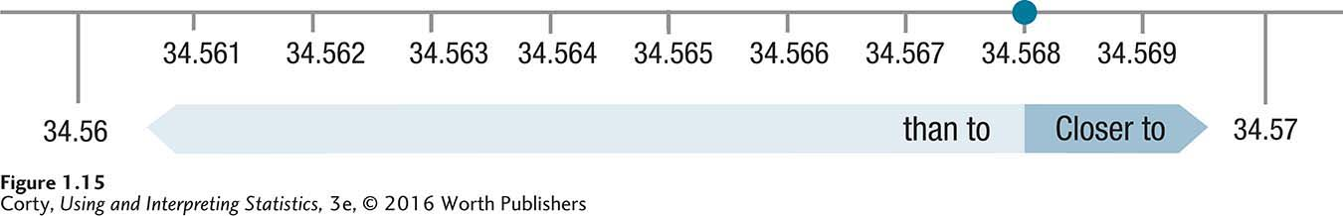
Rounding with Number Lines
Number Line Showing How to Round $35,400 to the Nearest Thousand Dollars
Number Line Showing How to Round 34.568 to Two Decimal Places

Slide 36
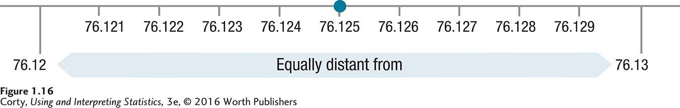
Rounding with Number Lines
Number Line Showing an Unrounded Number Equally Close to Both Rounding Options

Slide 37
Summary of Rules of Rounding
Rounding (APA recommendations)
Final answers should be rounded to two decimal places.
Numbers should not be rounded until the very end.
If the unrounded number is centered exactly between the two rounding options, round up.

